Slide 1
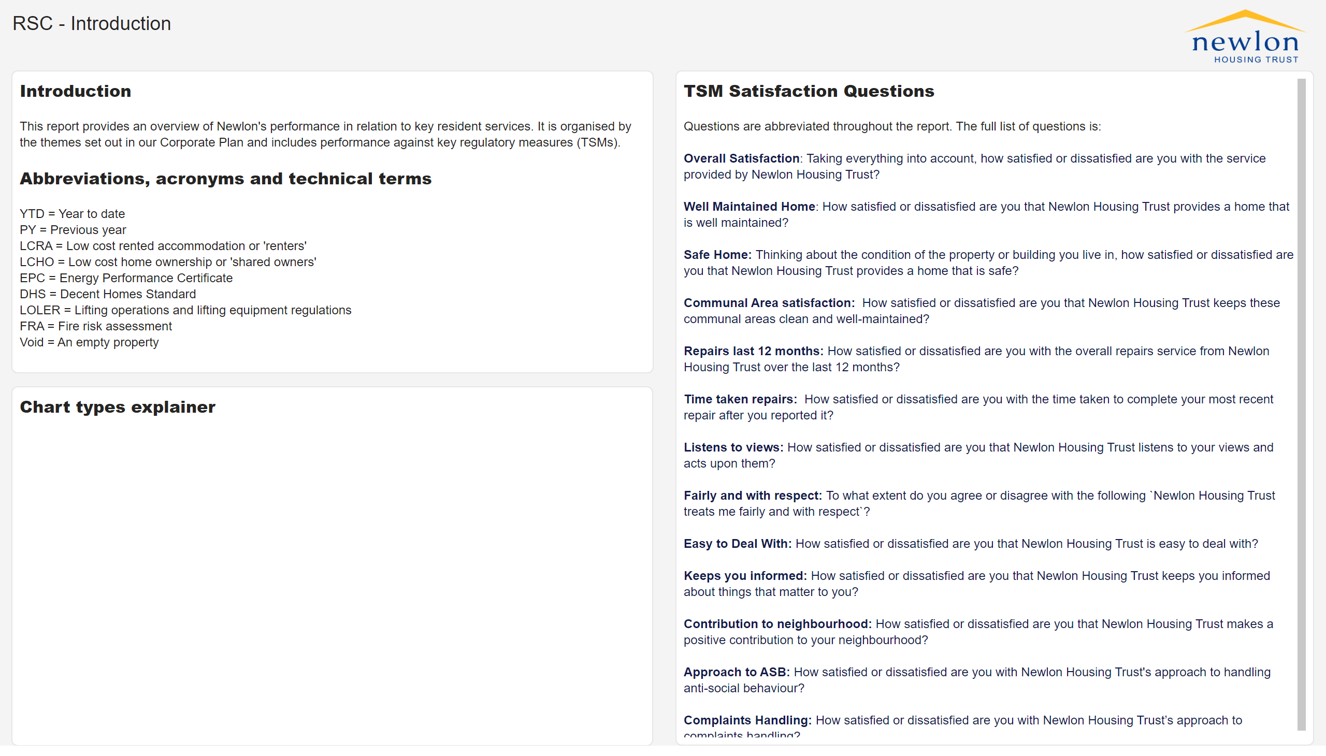
RSC - Introduction
TSM Survey
Survey results are based on 1,400 telephone interviews carried out by the independent market research company, Acuity, between June and December of 2024. The total is made up of 1,000 LCRA (renters) and 400 LCHO (shared owners) with interviews being evenly distributed across the survey periods.
The graphs on the next page track our results by month whilst the table on Page 3 (Satisfaction Comparison) and graphics on Page 4 (Dissatisfaction Comparison) allow you to compare our overall performance in 2024/25 with the previous year’s results.
Pages 5 to 8 summarise comments received from residents who expressed dissatisfaction with a particular aspect of the service. These are categorised by Acuity according to a coding system that they have developed whilst working with more than 100 housing providers over the past 25 years.
Notes:
image
No alt text provided
textbox
No alt text provided
textbox
No alt text provided
textbox
No alt text provided
textbox
No alt text provided

Slide 2
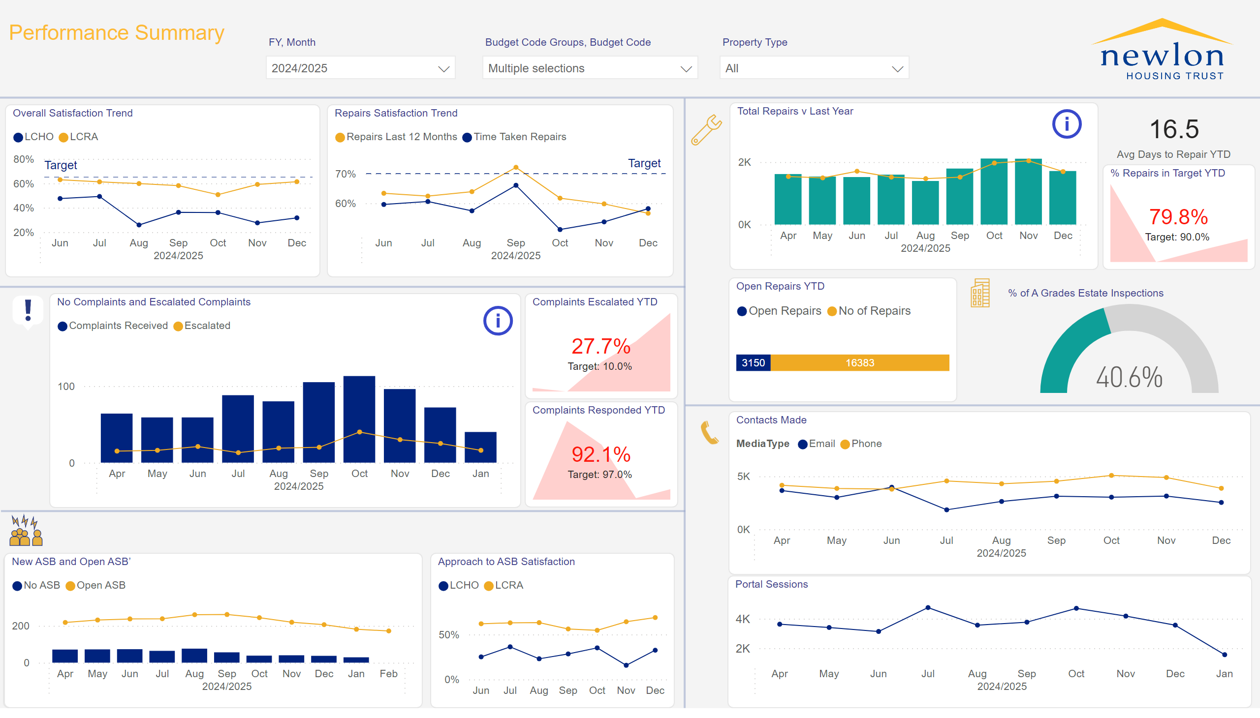
Residents Forum
Notes:
No Complaints and Escalated Complaints
No alt text provided
New ASB and Open ASB’
No alt text provided
textbox
No alt text provided
Total Repairs v Last Year
No alt text provided
actionButton
No alt text provided
actionButton
No alt text provided
actionButton
No alt text provided
image
No alt text provided
image
No alt text provided
image
No alt text provided
image
No alt text provided
Open Repairs YTD
No alt text provided
image
No alt text provided
tableEx
No alt text provided
card
No alt text provided
shape
No alt text provided
shape
No alt text provided
shape
No alt text provided
shape
No alt text provided
image
No alt text provided
Repairs Satisfaction Trend
No alt text provided
Overall Satisfaction Trend
No alt text provided
shape
No alt text provided
Complaints Escalated YTD
No alt text provided
% Repairs in Target YTD
No alt text provided
Complaints Responded YTD
No alt text provided
Portal Sessions
No alt text provided
Contacts Made
No alt text provided
gauge
No alt text provided
slicer
No alt text provided
Approach to ASB Satisfaction
No alt text provided
slicer
No alt text provided
slicer
No alt text provided

Slide 3
Satisfaction Comparison
 | LCRA 2024/25 | LCRA 2023/24 | LCHO 2024/25 | LCHO 23/24
Overall Satisfaction | 59% | 58% | 37% | 31%
Well Maintained Home | 61% | 58% | - * | - *
Safe Home | 68% | 67% | 50% | 43%
Repairs Last 12 Months | 63% | 61% | - * | - *
Time Taken Repairs | 58% | 58% | - * | - *
Communal Areas | 71% | 64% | 56% | 49%
Neighbourhood Contribution | 61% | 66% | 40% | 35%
Approach to ASB | 61% | 54% | 28% | 26%
Listens & Acts | 52% | 50% | 26% | 22%
Kept Informed | 71% | 68% | 51% | 42%
Fairly & with Respect | 70% | 69% | 51% | - *
Easy to Deal With | 61% | 61% | 31% | 27%
Complaints Handling | 36% | 29% | 11% | 15%

Slide 4
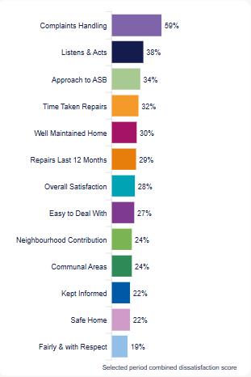
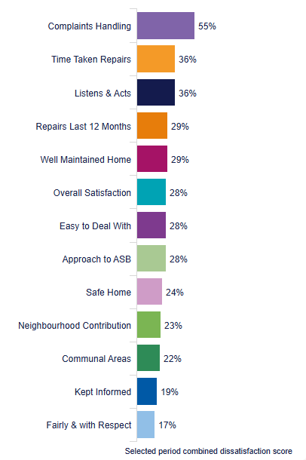
Dissatisfaction Comparison – LCRA ONLY
2023/24
2024/25

Slide 5
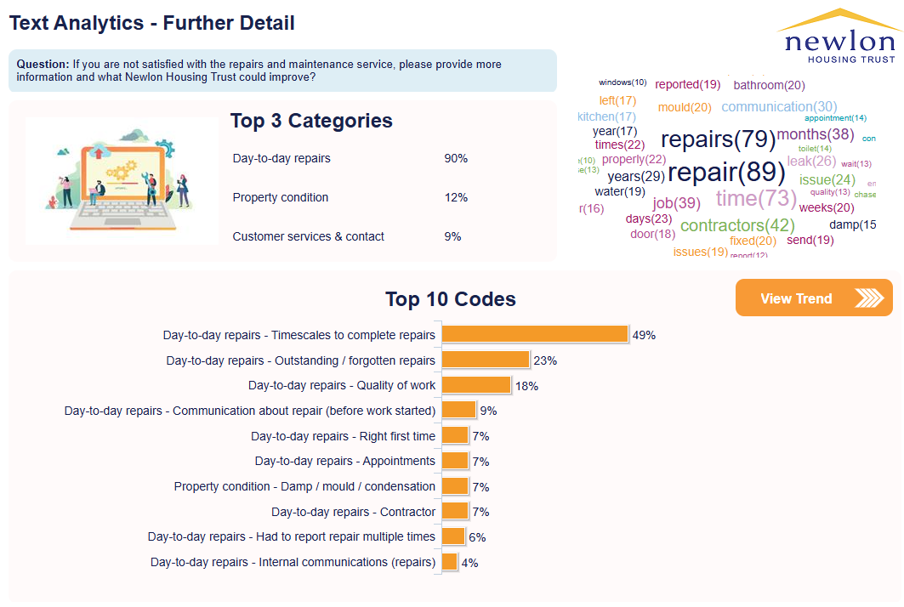
Dissatisfaction with repairs service - themes

Slide 6
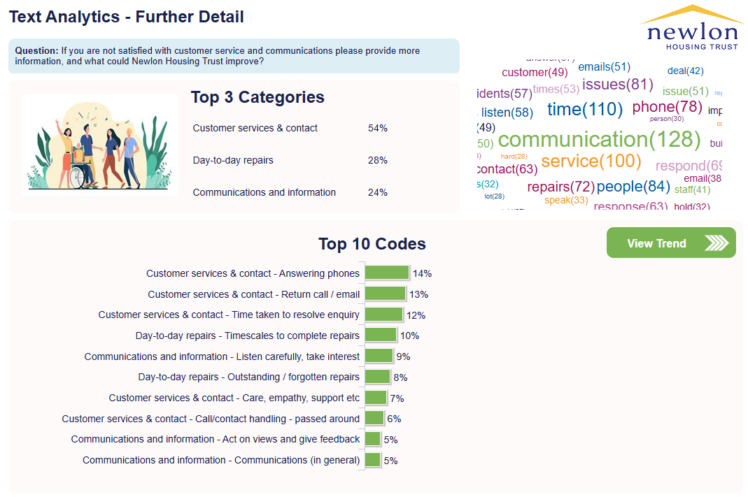
Dissatisfaction with communication - themes

Slide 7
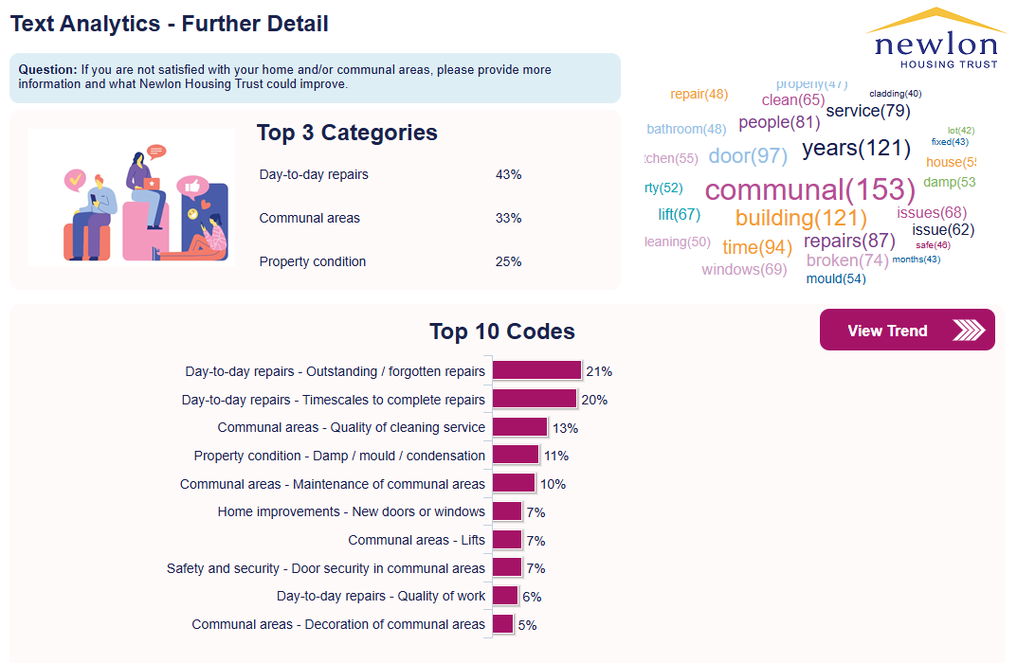
Dissatisfaction with home or communal areas - themes

Slide 8
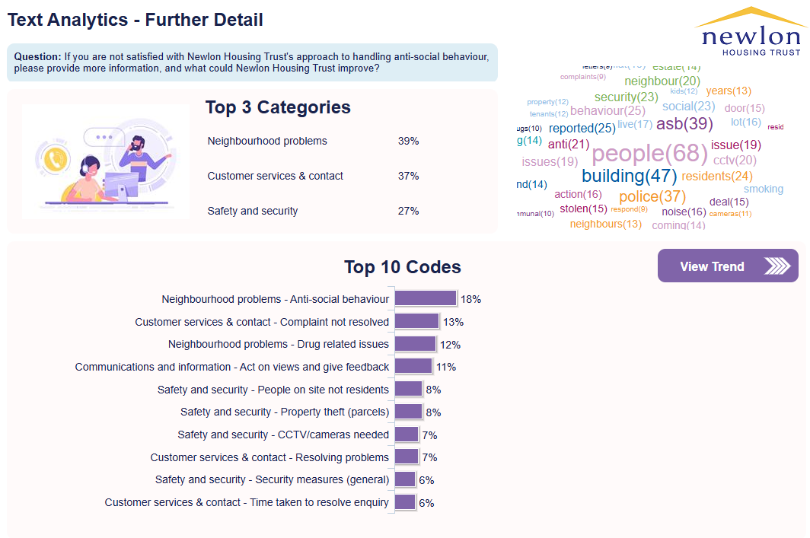
Dissatisfaction with ASB - themes

